Slide 1

Cyclistic Bike Riding: Analysis
Report by Peter Blackwell for Cyclistic management
February 18, 2023

Slide 2
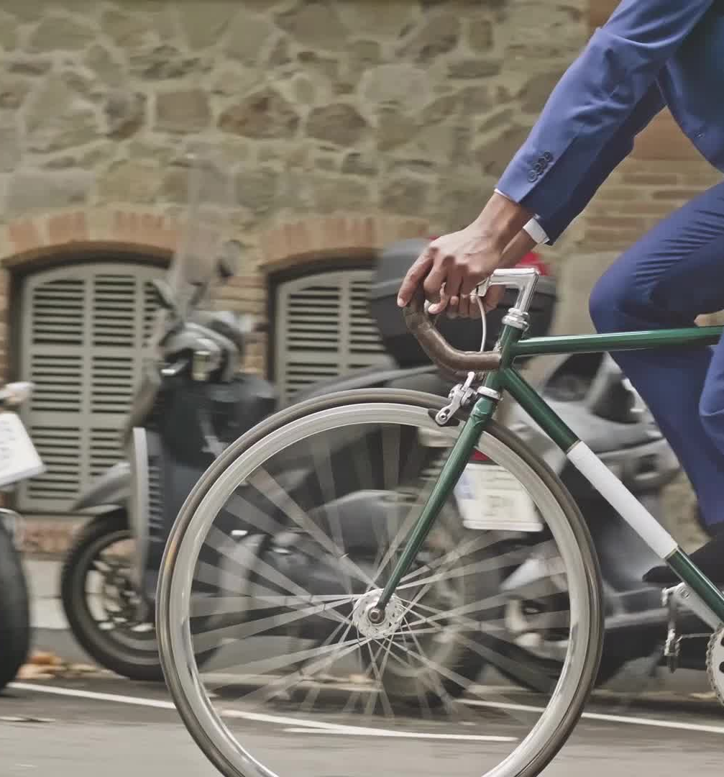
Question: How are casual riders of Cyclistic bikes using the system different than subscribers?
This document will present graphs and tables to show how annual members (subscribers) and casual riders use Cyclistic bikes differently so management can make determinations on how to market memberships to casual riders.

Slide 3

Data sources
The source data was taken from the Divvy system data website on AWS
( https://divvy-tripdata.s3.amazonaws.com/index.html )
for the months ranging from Jan. 2022 – Dec. 2022.
(For license see Appendix A)
Because this is uploaded by the Divvy system people, we should assume it conforms to the ROCCC principles (Reliable, Original, Comprehensive, Current, Cited)
The twelve monthly files were extracted and loaded into MS Excel to verify the integrity of the data before analyzing using the R language.

Slide 4
Ride length comparison based on day of week
Casual riders
Members
Day | # of rides | Duration (median)
Sun | 301,296 | 965
Mon | 210,757 | 828
Tue | 196,380 | 731
Wed | 203,576 | 725
Thu | 230,005 | 743
Fri | 248,796 | 793
Sat | 367,340 | 958
 | Duration is in seconds
Day | # of rides | Duration (median)
Sun | 297,722 | 588
Mon | 375,168 | 515
Tue | 411,244 | 516
Wed | 412,794 | 523
Thu | 415,887 | 527
Fri | 360,053 | 530
Sat | 338,273 | 602
 | Duration is in seconds

Slide 5
Ride length comparison based on month
Casual riders
Members
Month | # of rides | Duration (median)
Jan | 12,605 | 610
Feb | 15,144 | 673
Mar | 67,154 | 920
Apr | 91,897 | 896
May | 220,246 | 976
Jun | 292,067 | 901
Jul | 311,670 | 889
Aug | 270,089 | 825
Sep | 220,913 | 769
Oct | 151,324 | 703
Nov | 73,536 | 598
Dec | 31,505 | 517
 | Duration is in seconds
Month | # of rides | Duration (median)
Jan | 67,523 | 448
Feb | 74,034 | 453
Mar | 148,827 | 494
Apr | 180,663 | 493
May | 282,299 | 579
Jun | 328,281 | 607
Jul | 330,996 | 600
Aug | 335,224 | 580
Sep | 314,227 | 551
Oct | 262,943 | 496
Nov | 182,226 | 464
Dec | 103,898 | 442
 | Duration is in seconds

Slide 6
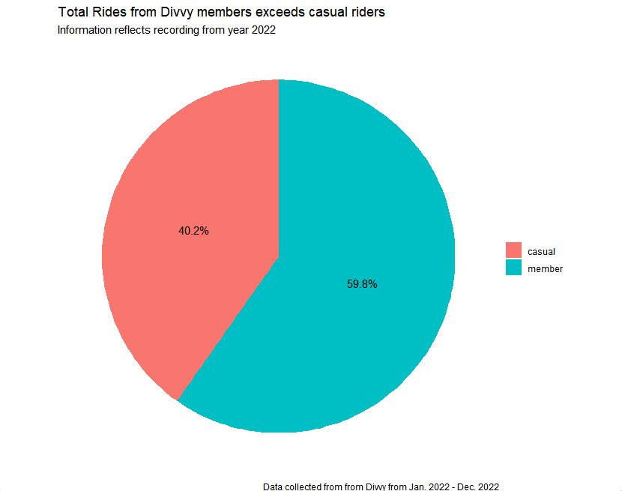

Slide 7
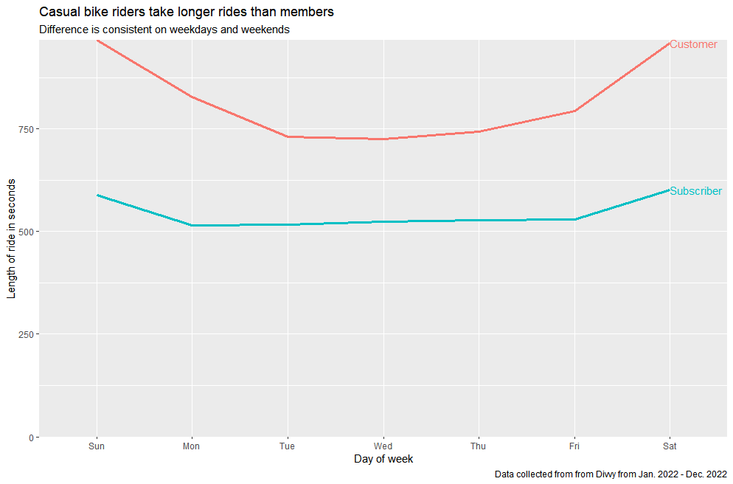

Slide 8
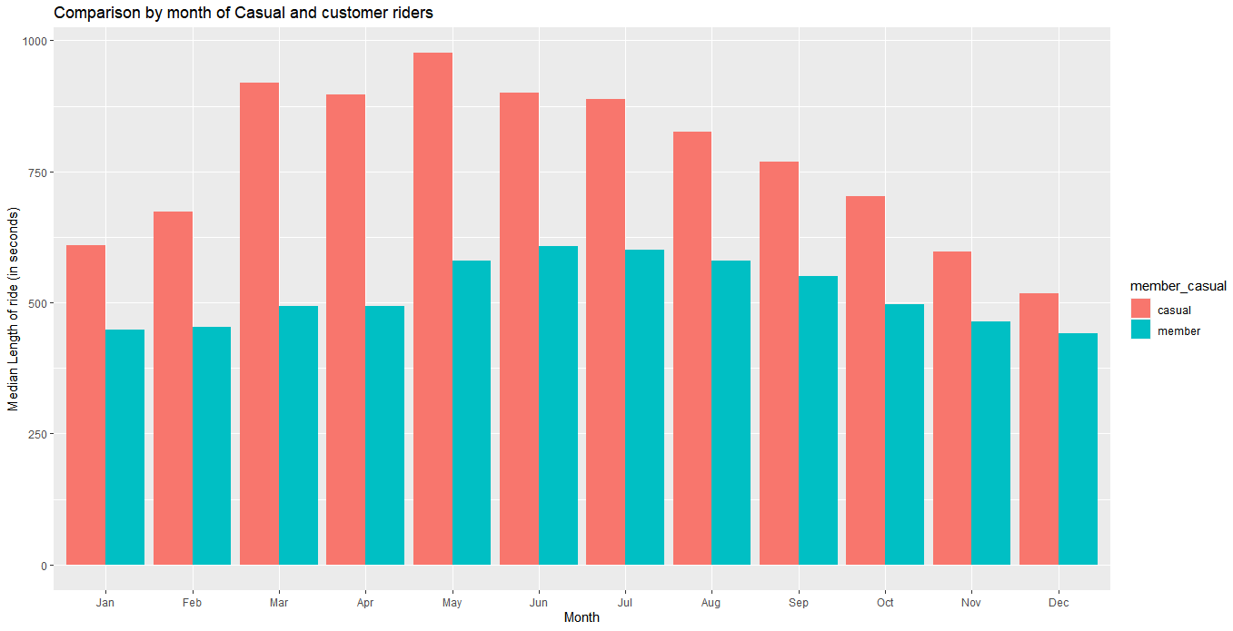

Slide 10
CONCLUSIONS FROM ANALYSIS:
Member riders are using more often on all days
Casual riders are taking longer rides on all days
Member riding is steady all year; casual rides spike in the summer months
RECOMMENDATIONS:
1. Management should look to appeal to casual riders via weekend campaigns, as the number of casual riders is 20% higher than on weekdays
2. Casual riders take longer rides. Look for ways to appeal to riders who take longer trips in general (targeted discounts, etc.)
3. A discount could be offered for casual summer riders to extend a yearly membership to colder winter months

Slide 11
Appendix
License:
Data has been made available by Motivate International Inc. under this license:
https://ride.divvybikes.com/data-license-agreement

